Slide 1
If Statements
Marek Kwasniewski
Automation & Tooling

Slide 2
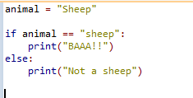
Conditions
Programming in any language is always about answering the basic True and False question.
Source code is organized into logical blocks. In Python defined by indentation.
The most basic and common type of flow control is the IF statement.
Lines of Python code be grouped together in blocks:
Blocks begin when indentation increases
Blocks can contain other blocks
Blocks end when indentation decreases to zero or to a containing block's indentation

Slide 3
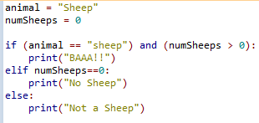
Comparison & Boolean
Comparison operators:
== equal to
!= not equal to
< less than
> greater than
<= less than or equal
>= greater than or equal
= is the assignment operator, == is a comparison operator
Python syntax: if keyword, condition, colon, indented block of code starting from next line.
Boolean operators: and, or, not
What are the results of below statements:
True and False
False and False
True or False
False or False
Mixing Boolean operators with comparison operators in Python:

Slide 4
Writing If Statements
Get a user’s input on how many books they read per year.
Get a user’s input on how many documentaries they watch per year.
Assign them different categories based on 0-5, 6-10, 11-20, and 20+ for the books and documentaries together.
If it takes an average of 9 hours to read a book and 2 hours to watch a documentary, how much time did they spend learning this year? Print the output for the user.
Tell the user which category do they fall into for both documentaries and books.
# Completed | Books | Documentary
0-5 | Novice | Novice
6-10 | Avid Reader | Avid Watcher
11-20 | Literary | Connoisseur
20+ | Bibliophile | Docuphile

